Slide 1
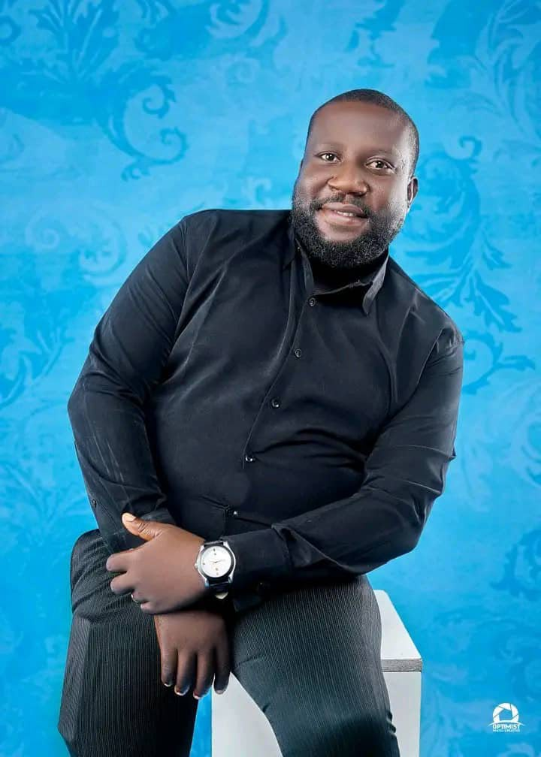
GENTLE BUSH
MC

Slide 2
Gentle Bush is a highly versatile stand-up comedian, entertainer, and Master of Ceremonies (MC) and content creator proudly hailing from Rivers State, Nigeria.

Slide 3
A renowned Biology Teacher and a seasoned Motivational speaker, he is a two-time winner of the award of “Comedian Of The Year” in Orashi Region of Rivers State.

Slide 4
Known for his unique blend of witty observations, relatable local humor, and sharp crowd engagement, he has established himself as a go-to entertainer for corporate events, weddings, and comedy shows alike.

Slide 5
Coming from a region famed for producing some of Nigeria’s finest comedic minds, Gentle Bush carries the rich storytelling tradition of Rivers State with charisma and style. He is the CEO of Laf-ta-lity

Slide 6
Gentle bush holds a bachelor’s degree in Biology from the University Of Nigeria, Nssuka, a Christian, a husband and a proud father of 3. He is an event consultant, planner, & manager.

Slide 7
Whether he is hosting a high-profile event or cracking ribs on a stand-up stage, his clean, engaging, and dynamic style guarantees an unforgettable experience for any audience.

Slide 8
LADIES AND GENTLEMEN,
MC GENTLE BUSH

